Slide 1
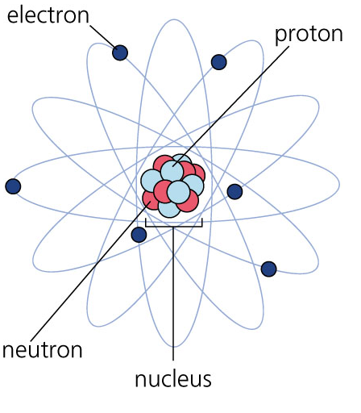
Atomic Structure
Protons are located in the _______ of an atom
Protons have a __________
charge

Slide 2
Atomic Structure
Neutrons are located in the nucleus of an atom
Neutrons do not have a
charge( ___________)

Slide 3
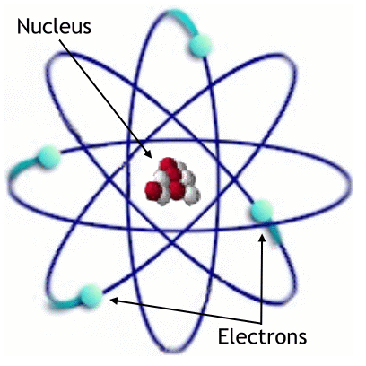
Atomic Structure
Electrons are located _________ of the nucleus
Electrons have a
__________ charge

Slide 4
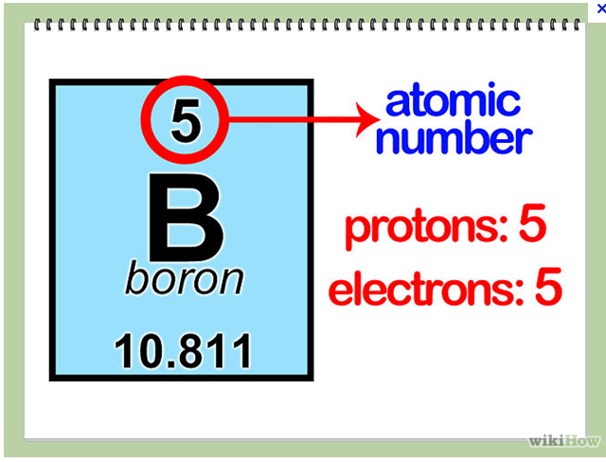
Protons
The # of protons is same as:
  The ___________ Number
The # of electrons is same as:
  The ____________ Number

